Slide 1
Multiprocessor
Prepared by
KEYUR PATEL

Slide 2
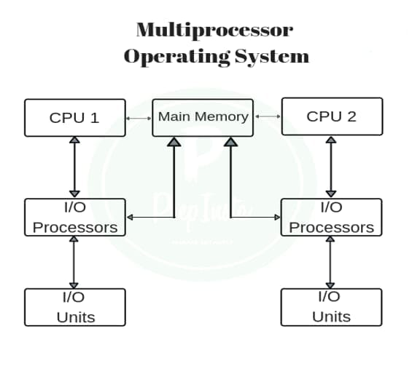
Introduction
A Multiprocessor is a computer system with two or more central processing units (CPUs) share full access to a common RAM.
The main objective of using a multiprocessor is to boost the system’s execution speed, with other objectives being fault tolerance and application matching.

Slide 3
Types of Multiprocessor
shared memory multiprocessor
distributed memory multiprocessor.
In shared memory multiprocessors, all the CPUs shares the common memory but in a distributed memory multiprocessor, every CPU has its own private memory.

Slide 4
Application of Multiprocessor
As a uniprocessor, such as single instruction, single data stream (SISD).
As a multiprocessor, such as single instruction, multiple data stream (SIMD).
Multiple series of instructions in a single perspective, such as multiple instruction, single data stream (MISD), which is used for pipelined processors.
Inside a single system for executing multiple, individual series of instructions in multiple perspectives, such as multiple instruction, multiple data stream (MIMD).
High-Performance Computing
Artificial Intelligence and Machine Learning
Real-Time Systems
Overall, multiprocessor systems have a wide range of applications in different fields, where performance and efficiency are critical.

Slide 5
Advantages
Improve performance ratio
To avoid expense of centralized system
Tasks are divided in module
Improves Reliability

Slide 6
Multiprocessor can be characterized by two main categories:
processor is a single computer that includes multiple processors. Communication between them may occur by sending messages from one processor to the other or by sharing common memory.

Slide 7
Thank you

